Slide 1
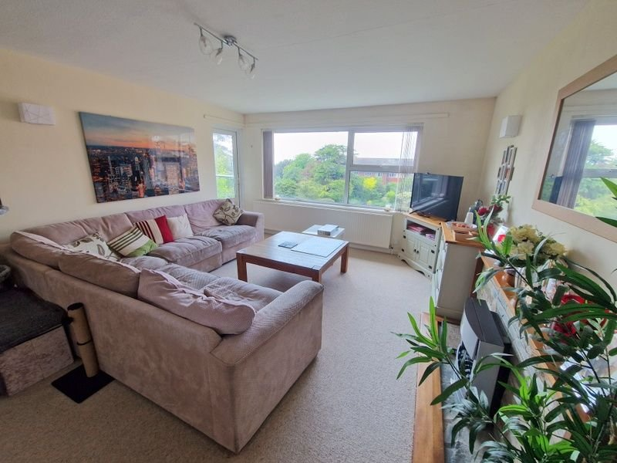
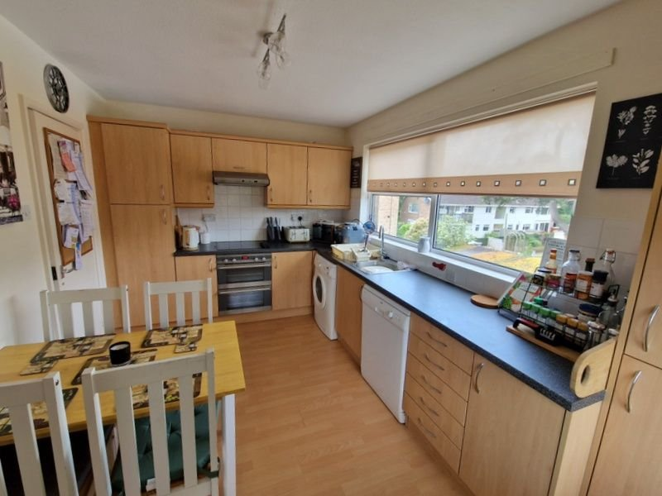
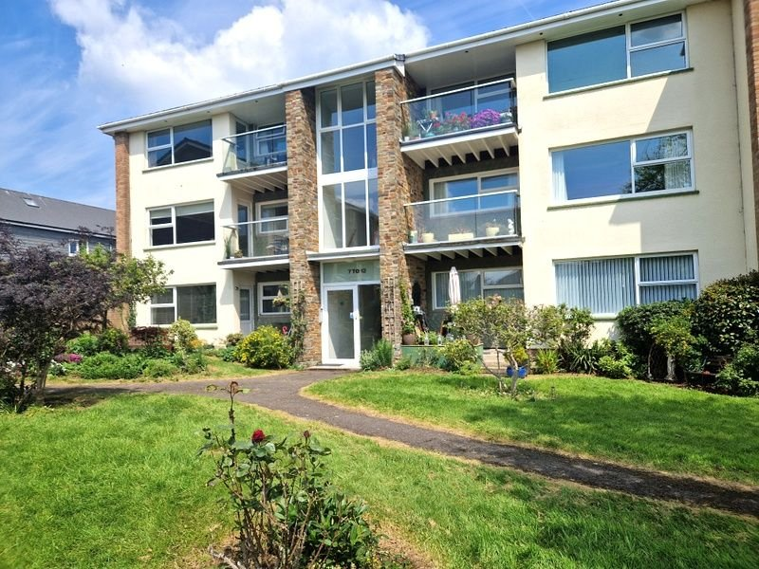
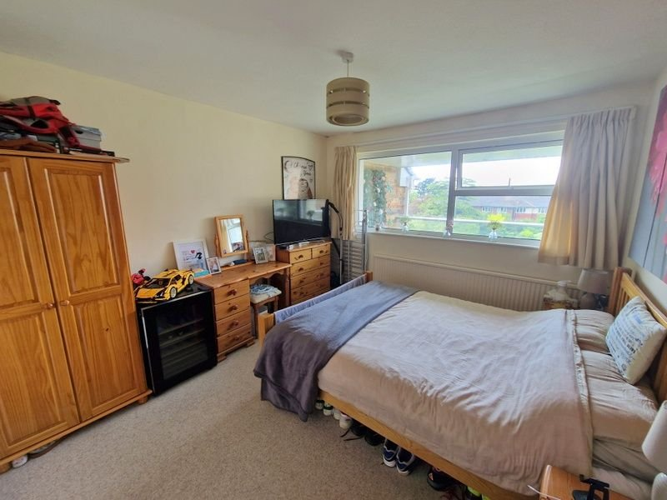
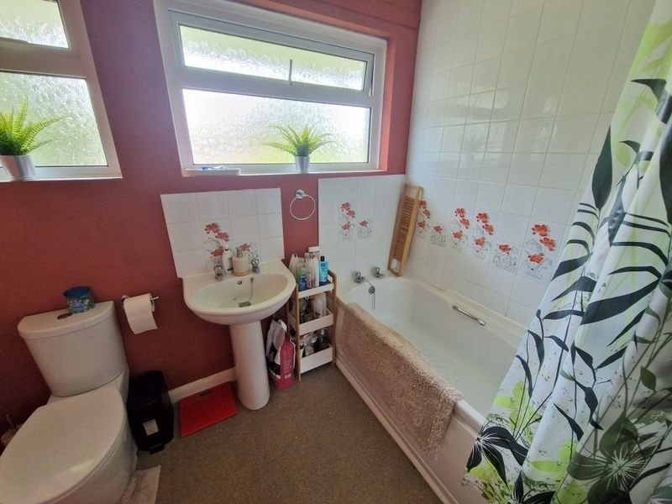
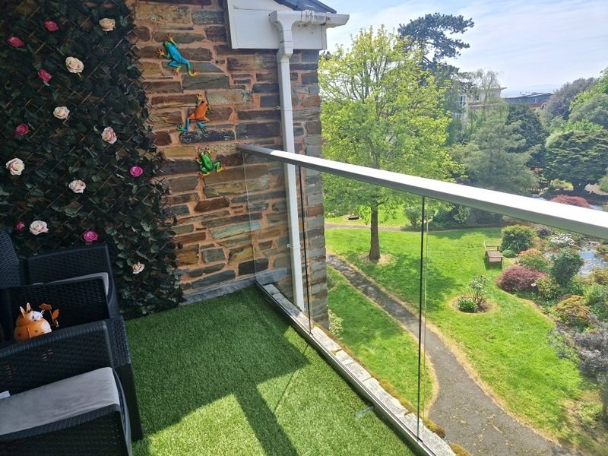
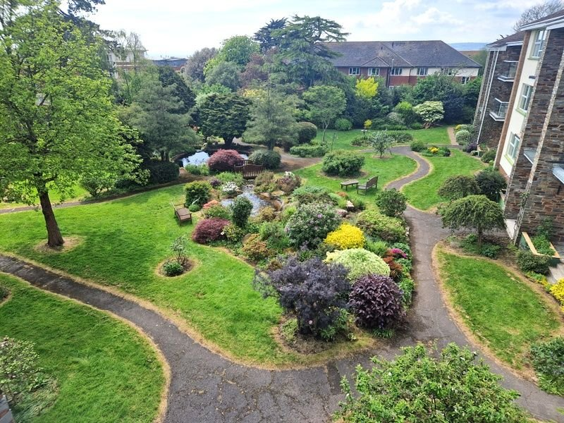
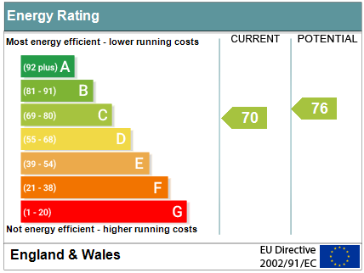
www.pennys.net
Flat 11 Aldborough Court, 21 Douglas Avenue, Exmouth, EX8 2HA
GUIDE PRICE £289,950
TENURE Freehold
Bright And Spacious Top Floor Purpose Built Apartment Located In Sought After Area Of Exmouth With Stunning Communal Gardens and Car Port
Good Size Lounge/Dining Room * Sun Balcony With Pleasant Open Outlook * Kitchen/Breakfast Room * Two Double Bedrooms * Bathroom/Wc * Double Glazed Windows And Gas Central Heating * Distant Views Towards The Coastline * Viewing Recommended
Pennys Estate Agents Limited for themselves and for the vendor of this property whose agents they are give notice that:- (1) These particulars do not constitute any part of an offer or a contract. (2) All statements contained in these particulars are made without responsibility on the part of Pennys Estate Agents Limited. (3) None of the statements contained in these particulars are to be relied upon as a statement or representation of fact. (4) Any intending purchaser must satisfy himself/herself by inspection or otherwise as to the correctness of each of the statements contained in these particulars. (5) The vendor does not make or give and neither do Pennys Estate Agents Limited nor any person in their employment has any authority to make or give any representation or warranty whatever in relation to this property.
PENNYS ESTATE AGENTS
2 Rolle House, Rolle Street, Exmouth, Devon, EX8 2SN
Tel: 01395 264111 EMail: help@pennys.net

Slide 2
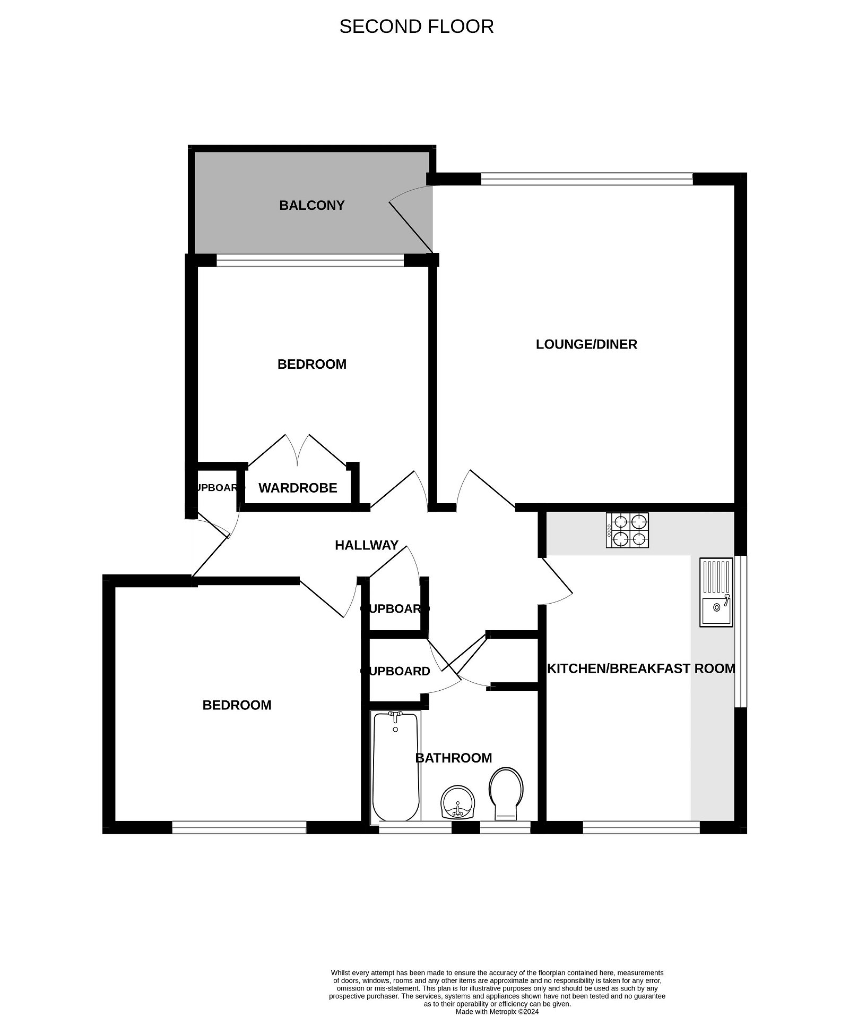
Flat 11 Aldborough Court, 21 Douglas Avenue, Exmouth, EX8 2HA
Communal entrance with door intercom system with stairs rising to upper floor. Private front door giving access to:
RECEPTION HALL: Radiator, telephone point, deliveries cupboard, coats cupboard.
LOUNGE/DINING ROOM: 17’11 x 13’11 (5.46m x 4.24m) A bright spacious room with double glazed window overlooking the beautifully kept and colourful communal gardens. TV point, radiator, stone fire surround with wood mantel over, double glazed door giving access to SUN BALCONY with artificial lawn, glass balustrade and again with lovely views over the gardens and coastline beyond.
KITCHEN/BREAKFAST ROOM: 14’4 x 8’10 (4.37m x 2.69m) A bright dual aspect room with double glazed windows to rear and side elevation fitted with a range of pattern worktops with inset single drainer sink unit, cupboards, drawer units, dishwasher, space and plumbing for washing machine beneath worktops, electric hob with built-in oven below and extractor hood over. Tiled surrounds, wall mounted cupboards, upright larder style cupboard housing Worcester gas boiler for hot water and central heating. Wood laminate flooring, radiator.
BEDROOM 1: 14’ x 11’11 (4.27m x 3.63m) Radiator, built in wardrobe. Double glazed window overlooking the covered balcony and communal gardens beyond. Sea views.
BEDROOM 2: 12’3 x 11’8 (3.73m x 3.56m) Double glazed window to rear elevation, radiator.
BATHROOM/WC: 8’4 x 8 (2.54m x 2.44m) Spacious bathroom comprising; bath with splashback areas and shower unit over, shower curtain and rail, pedestal wash hand basin with tiled splashback, WC with push button flush, two built in cupboards, radiator. Two double glazed windows both with pattern glass.
OUTSIDE: Aldborough Court is set in the highly sought after ‘Avenues’ area of Exmouth and enjoys stunning communal gardens which include seating areas, neatly kept lawned areas of garden with well stocked shrub and flower beds which offer an abundance of colour, Lily pond with feature bridge over. The property also benefits from a CAR PORT.
TENURE AND OUTGOINGS: We understand that the property is held on a 999 year lease from 2003 with a share of the freehold. The service charge is £380 per quarter payable to the management company.
FLOOR PLAN:

